Slide 1

THIRD EYE FOR THE BLIND
Review 2
Guide : Prof. ASISH KUMAR DALAI (department of cse)

Slide 2
TEAM DETAILS: BATCH:180272
1)TAHA JUNAID-18BCD7072
2)MOHAMMED TAQI UDDIN-18BCN7050
3)DARRAIN SAA-EYD -18BCN7009
4)SHOAEB-18BEC7067
5)KRISHNA-18MIS7233
6)MAHESH-18MIS7163

Slide 3
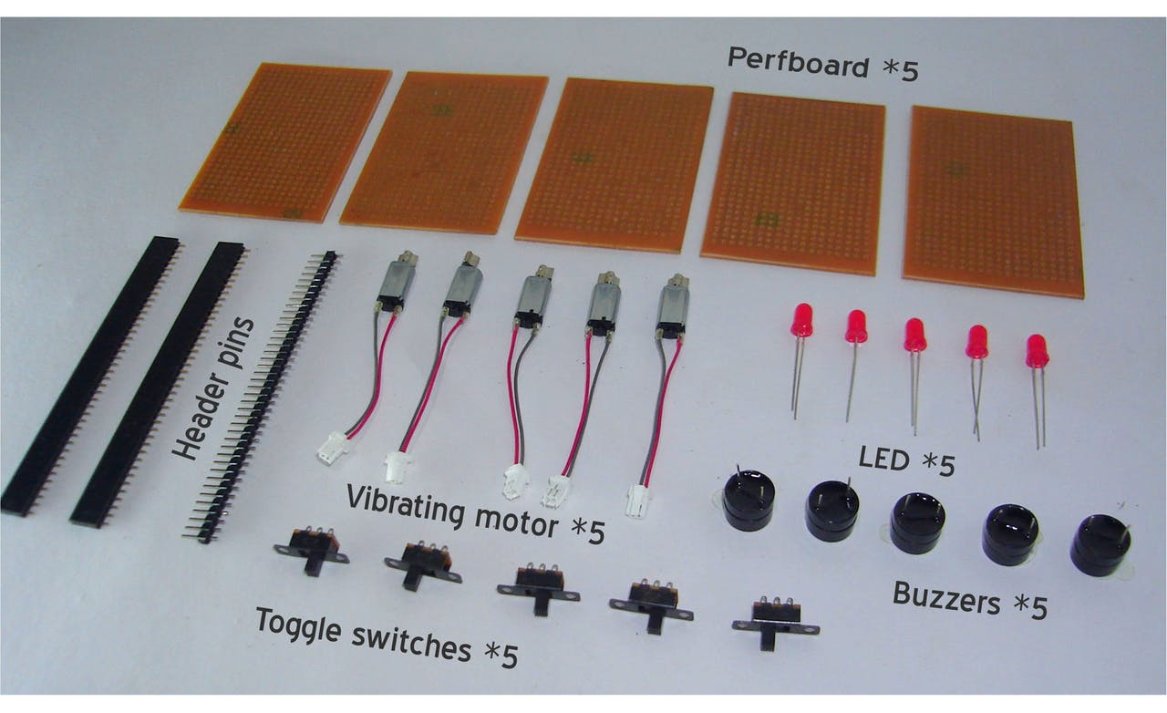
THINGS USED IN THIS PROJECT:
Arduino pro mini 328
5 ultrasonic sensor
Breadboard/perfboard
Vibrating motor
Buzzer
5mm led: RED
Switch
Female header
Male header
Jumper wire
3.7 v battery

Slide 4
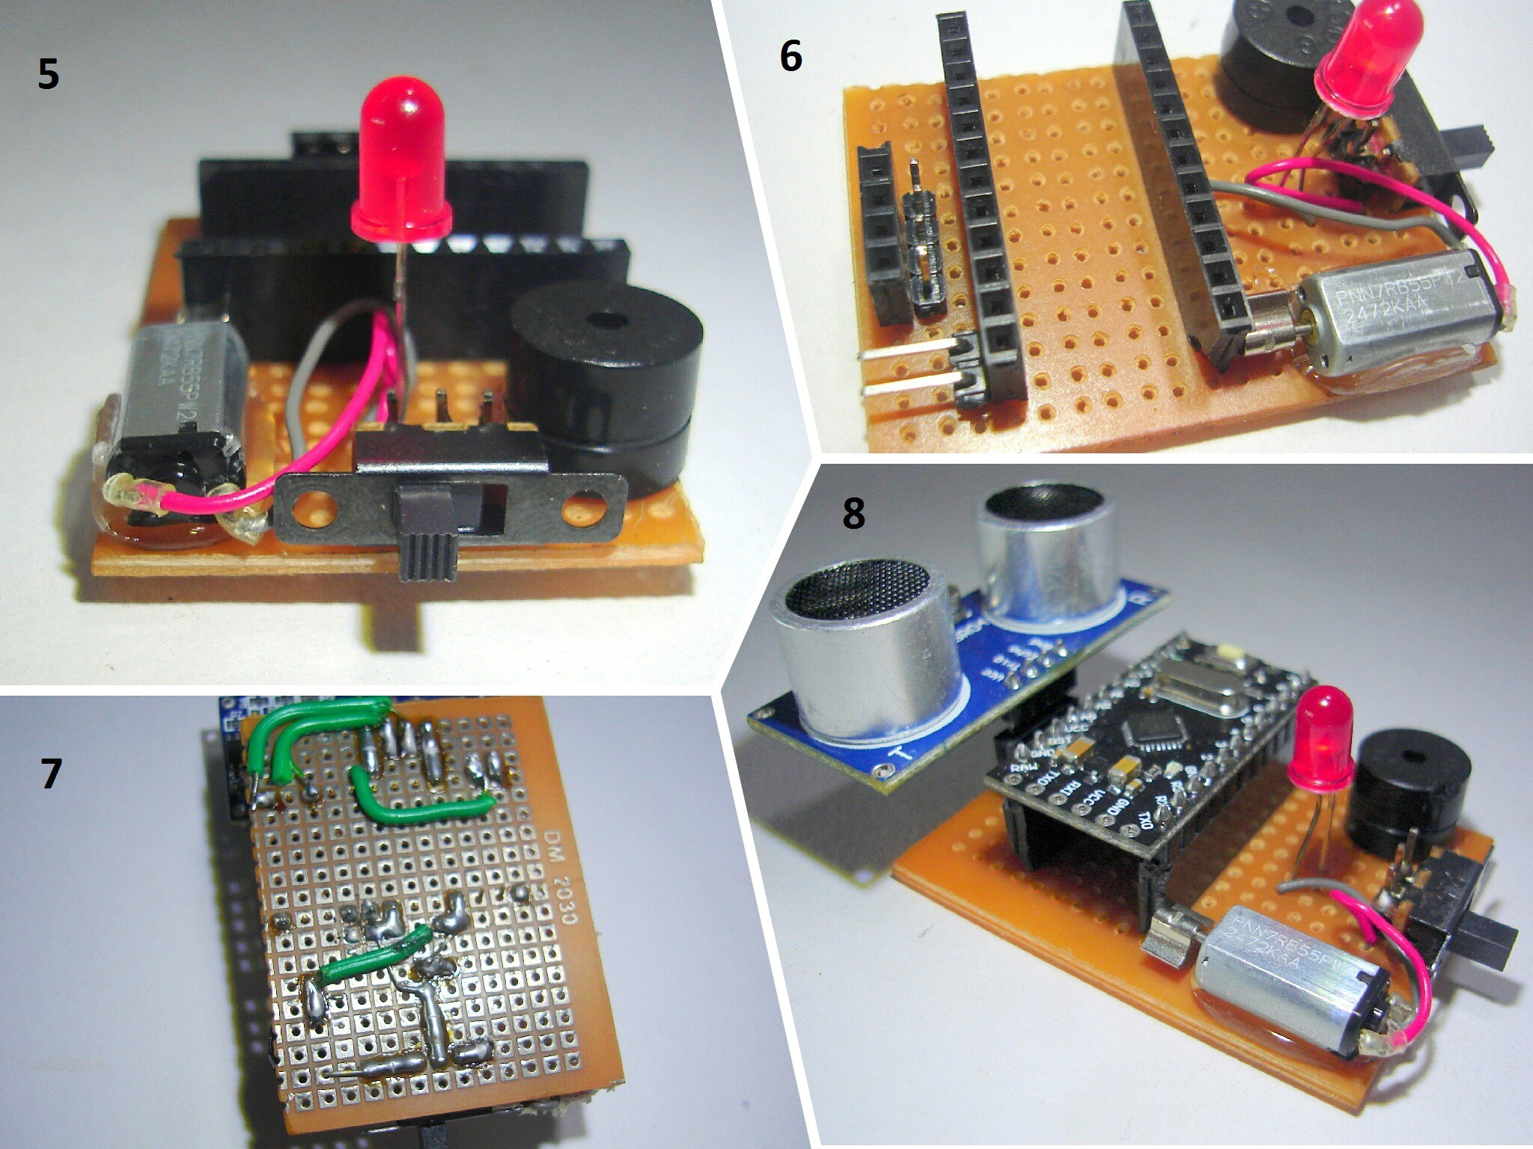
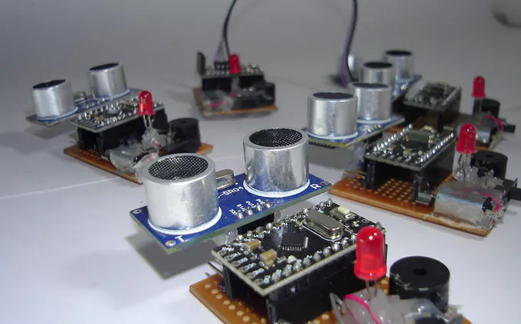
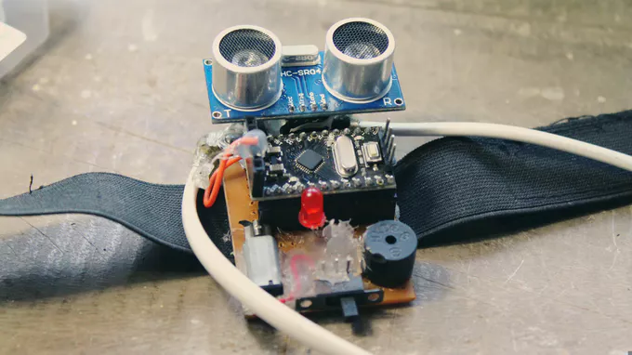
Prototype of the model :

Slide 5
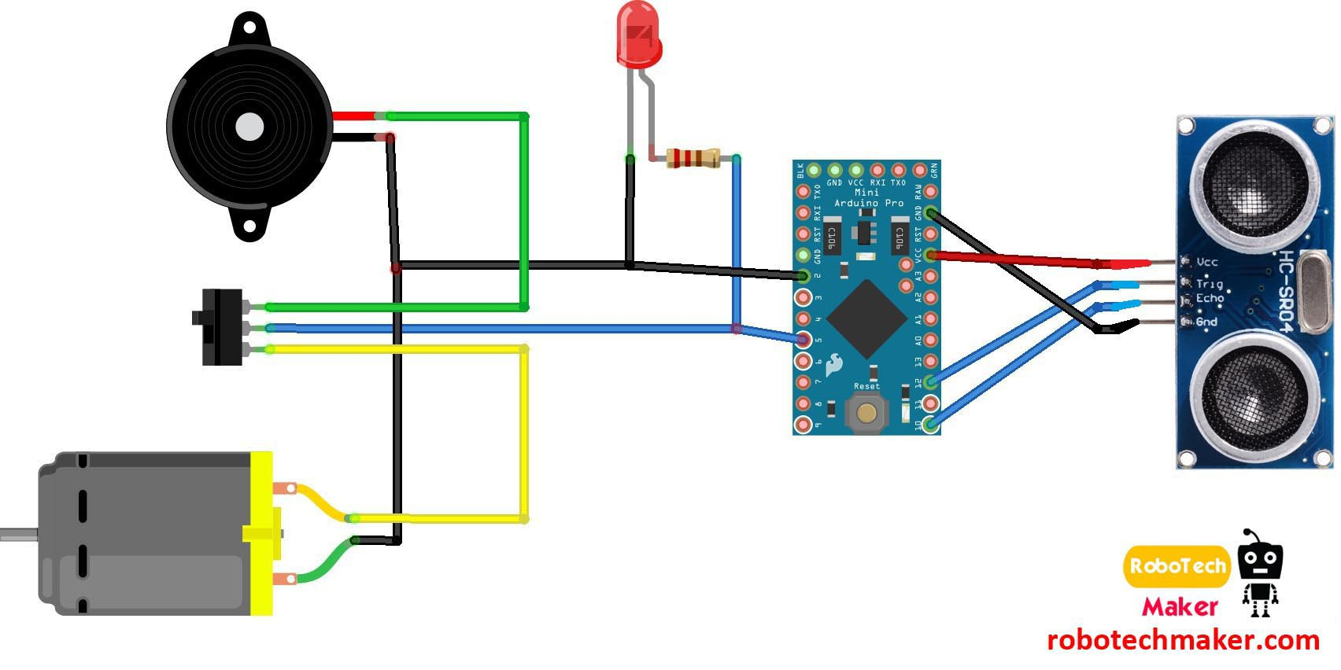
PROJECT CIRCUIT DIAGRAM (using Arduino pro mini)

Slide 6
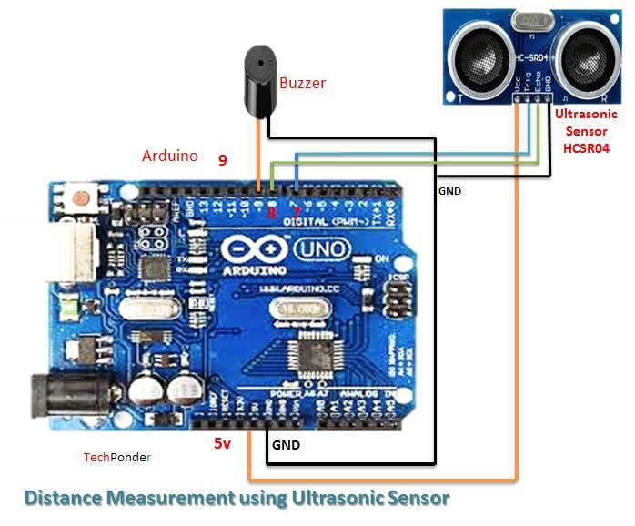
CURRENT CIRCUIT DIAGRAM (using Arduino uno)

Slide 7
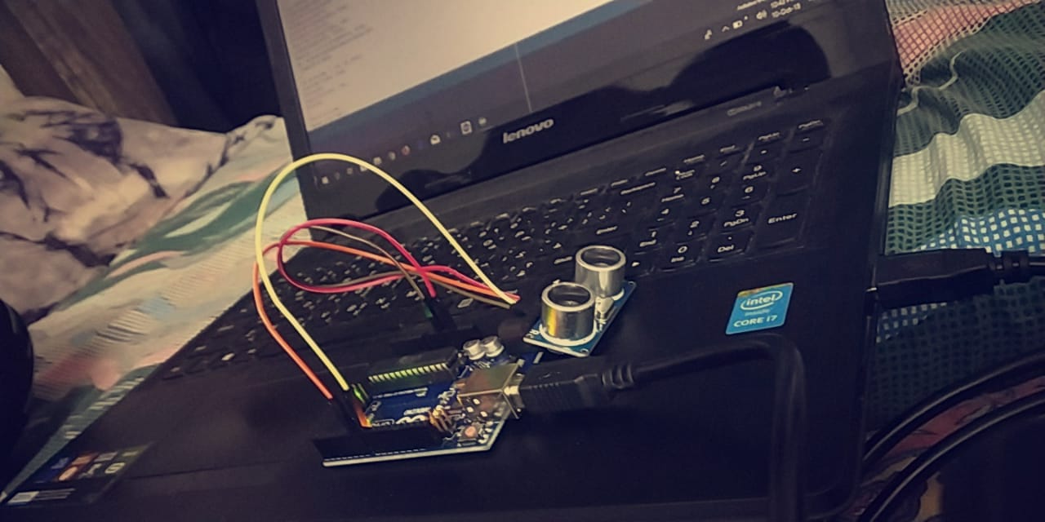
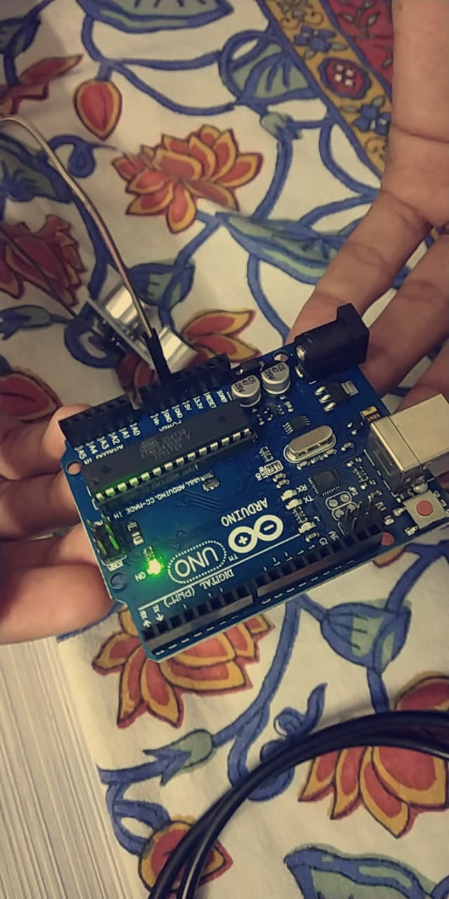
Progress throughout the week:
Received the Arduino Uno
Uploaded the program successfully

Slide 8
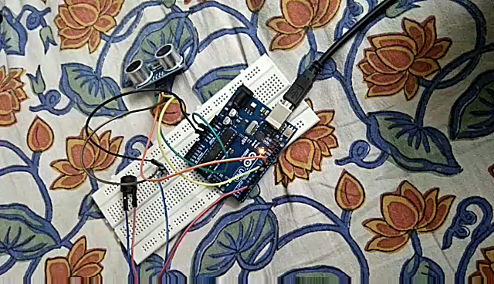
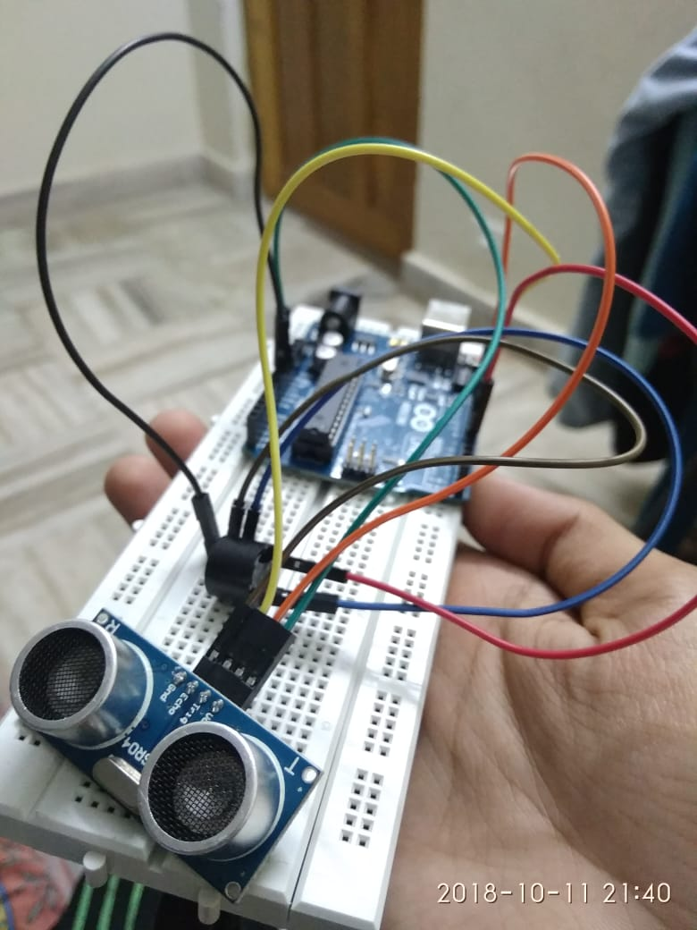
Tested the model with teammates to get positive results.

Slide 9
TIME LINE CHART
Submission
Integration with IDE
Coding-Arduino IDE
Hardware Analysis
Pbm Identified
Literature Survey
Modules | Aug1-4 week | Sept 1st week | Sept 2nd week | Sept 3rd week | Sept 4th week | Oct 1st week | 2nd week | 3rd week | 4th week | Nov 1st week

Slide 10
REFERENCE:
https://www.robotechmaker.com/2016/11/third-eye-for-blind.html
www.google.com
www.Wikipedia.com

Slide 11
THANK YOU !!!!

